Slide 1
Predictive Modelling for Ride-Hailing service
Group 23

Slide 2
Aims
Demand forecasting:
Predict how many rides will be requested every hour to optimise driver deployment and minimise wait times.
Revenue optimisation:
Identify the most profitable times and locations to maximise driver earnings.

Slide 3
Data preprocessing
We implemented a multi-stage cleaning process to ensure model reliability. This included removing:
Data anomalies: Negative fare amounts, zero-distance trips, missing metadata, and chronologically impossible records.
Outliers: Trips exceeding 5 hours or fares over $100, to prevent rare events from distorting typical operational expectations.
Approximately 15% of the 41 million raw records were removed.

Slide 4
Feature engineering
Engineered key features so the models were taught to recognise patterns specific to New York City:
Lag Features: 1-hour, 2-hour, and 24-hour look-backs to capture immediate demand momentum.
Temporal & Operational Tags: Categorised data by hour, day, month, and specific NYC rush hour windows to differentiate commuting patterns from leisure demand.
Hourly Zone-Level Performance: Transformed individual trips into a gapless hourly timeline for all 69 Manhattan zones.

Slide 5
Demand analysis
Model Selection: We evaluated Linear Regression, Random Forest, and Neural Network, ultimately selecting Random Forest.
Predictive power (R Squared) of 0.91- successfully explaining 91% of the real-world variance in Manhattan's hourly demand
Operation accuracy (MAE) of 13.1- our staffing predictions are typically accurate to within 13 rides per hour, per zone.

Slide 6
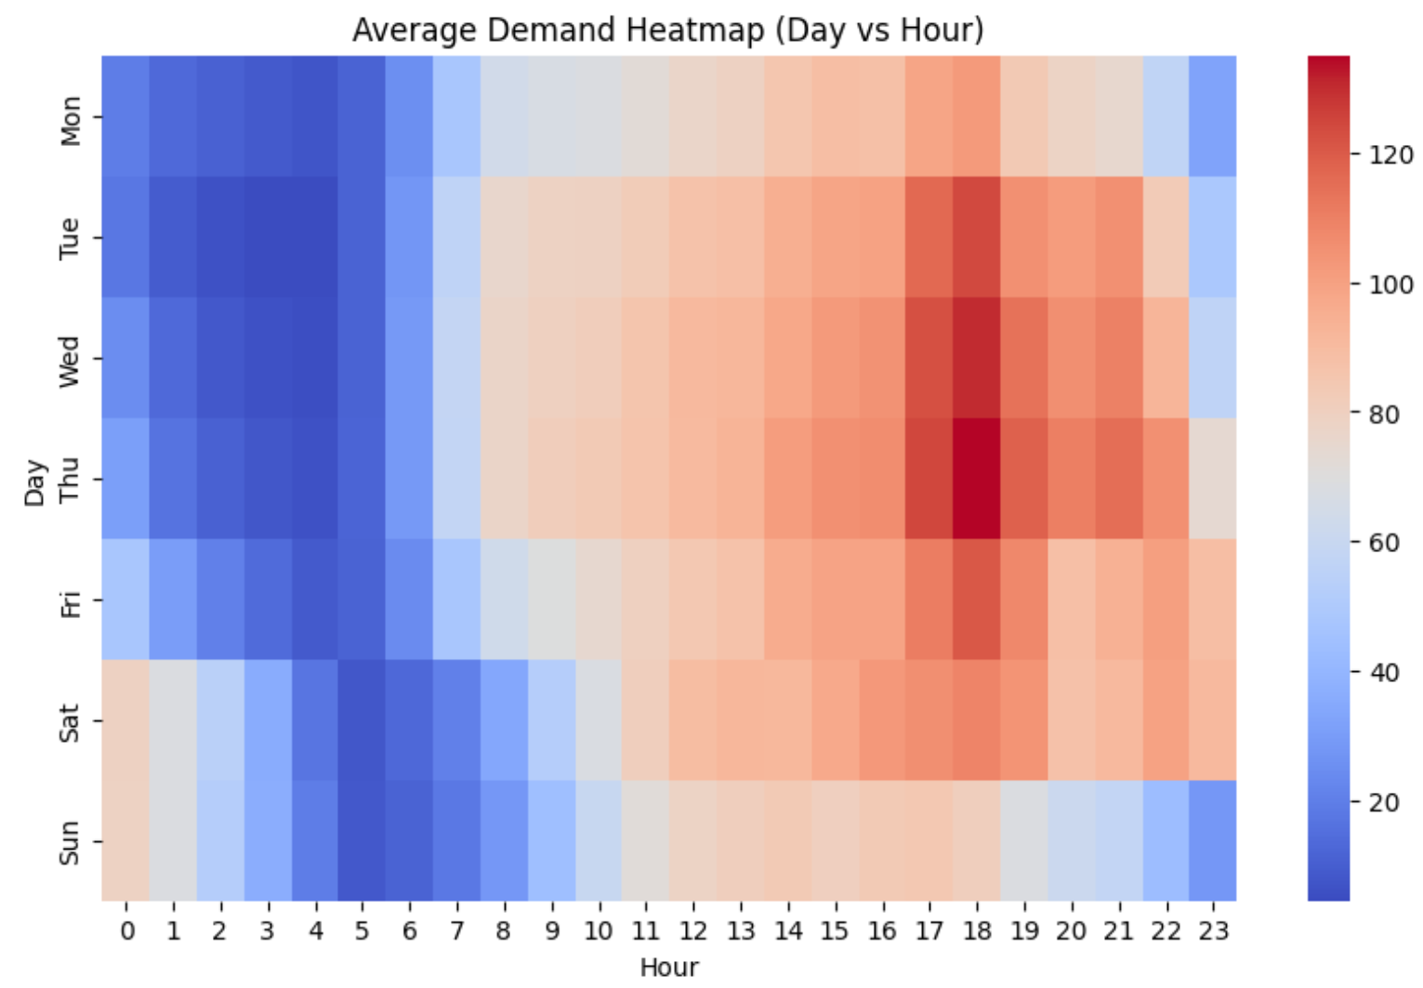
The primary drivers of demand:
Historical momentum: Busy zones tend to stay busy.
Temporal features:
Peaks during the early evening weekday work rush- but so does standard deviation.
Demand starts later in the day on weekends.
Sunday exhibits the lowest overall demand.
Notes:
Historical Momentum (Lags): The strongest predictor is the volume recorded in the previous 60 minutes Temporal Features: Rider behaviour shifts significantly based on the specific hour of the day and whether it is a weekday or weekend.

Slide 7
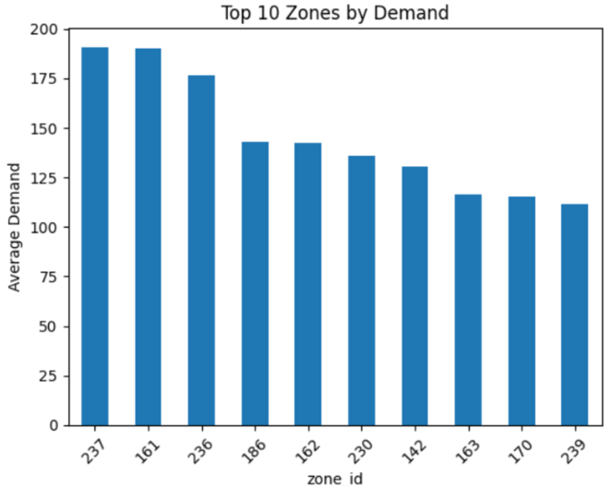
Demand also shows zone dependencies.
Highest predicted demand in zones 237, 161, and 236.
These represent the most reliable locations for consistent trip turnover.

Slide 8
Revenue insights
Model Selection: We evaluated Random Forest, XGBoost and Neural Network, ultimately selecting XGBoost.
Predictive power (R Squared) of 0.90- successfully explaining 90% of the real-world variance in hourly revenue across Manhattan.
Operation accuracy (MAE) of 342- predicts the total hourly revenue with a typical error of roughly $343.

Slide 9
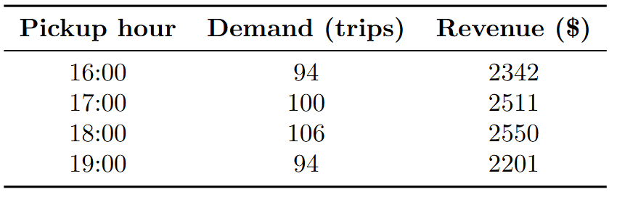
Revenue is dictated by the same drivers as demand: historical momentum and temporal features.
Mirrors demand patterns: 16:00 to 19:00 is the most critical window for maximising profitability.
Total earnings are fundamentally driven by trip density rather than isolated high-fare trips.

Slide 10
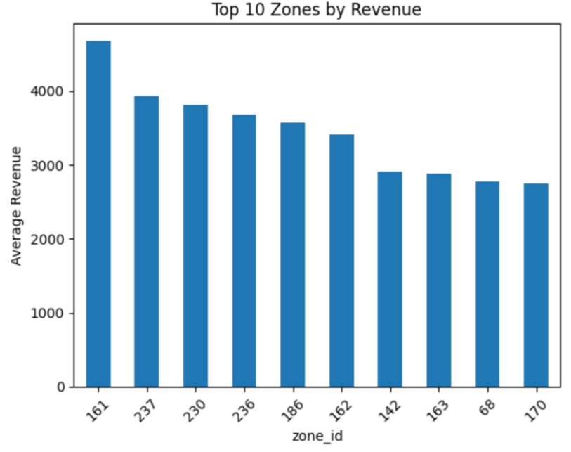
Top revenue-generating zones largely over-lap with high-demand areas (161 and 237).
Ordering of these zones varies between the demand and revenue models.
Certain neighbourhoods may yield higher revenue through longer-distance trips

Slide 11
Recommendations
The Afternoon Rush (16:00–19:00): Maintain high driver density to capture peak revenue and minimise wait times.
Demand buffer: Implement a driver surplus during the 18:00 peak to absorb high variability and ensure service consistency.
Weekend Shift-Delay: Move weekend start times from 07:00 to 10:00 to align supply with the late-evening leisure surge.
Scheduled downtime: Use low-demand Sundays for vehicle maintenance and driver downtime to maximise the reliability of the service.
Zone prioritisation: Strategically position drivers within high-turnover Zones (37, 161,236, 230, 186 and 162).

Slide 12
Limitations
Current models trained on 2024 NYC Taxi data, relying on historical and temporal patterns, so they don’t account for :
Real-time shocks (e.g. heavy snow, protests or sudden road closures).
Future Urban shifts (e.g. adjustments to work from home policies or public transport infrastructure)
Future iterations of the models could include real-time weather and traffic feeds, as well as a re-training pipeline that updates the model daily with internal platform data.

